Slide 1
Constructing Hangman
Tutorial #28

Slide 2
OBJECTIVE

Slide 3
Objective
The objective of this tutorial is for you to learn how to build something from the ground up.

Slide 4
TEXTPLANATION

Slide 5
Textplanation
Back when you reached Level 1, you were given a crash course on debugging. As you move into higher levels, those tools go from being helpful to being absolutely essential. Let’s face it. Your programs need to work and the odds of them working on the first try are pretty remote. Those odds don't get better.

Slide 6
Textplanation
When testing and debugging, the first thing you need to do is identify and replicate the problem. If you can't recreate the circumstances under which the problem occurs, you can't isolate the problem.

Slide 7
Textplanation
Once you've got your error in your sights, it's time to target the cause. Usually, there will be some clue in the variables. One of the most effective debugging tools is the ability to step through your program line by line and see how the variables behave. Your debugger offers you the ability to step into, out of, and over functions. There’s a watch window into which you can load your variable names and see how their values change as you go. You can set breakpoints so that execution will stop when you want it to stop and you can go from there. Finally, you have the console, a text output window that you can use to manipulate your code as you debug it.

Slide 8
CONSTRUCTION

Slide 9
Construction
Create a folder somewhere on your drive and label it Hangman.
Open up notepad++.
Save the empty file to your folder and name the file “index.html”.
All first pages on a website are called index.
This is a long construction so have patience with it and look for the changes. Try things as they happen and debug as you go.

Slide 10
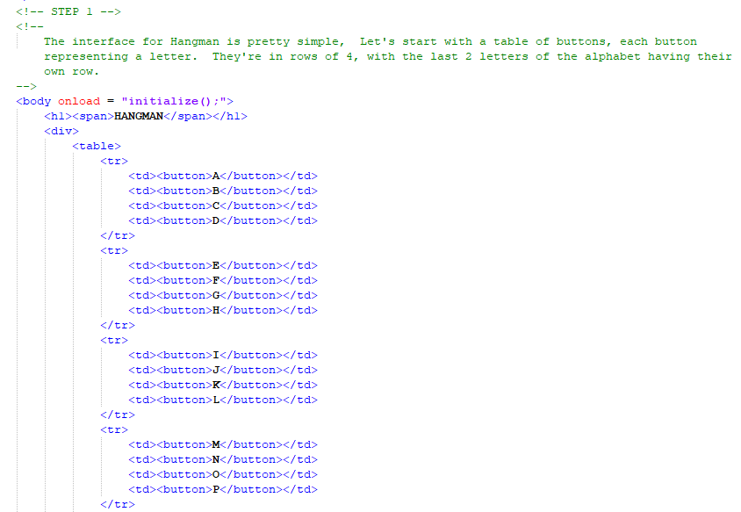

Slide 11
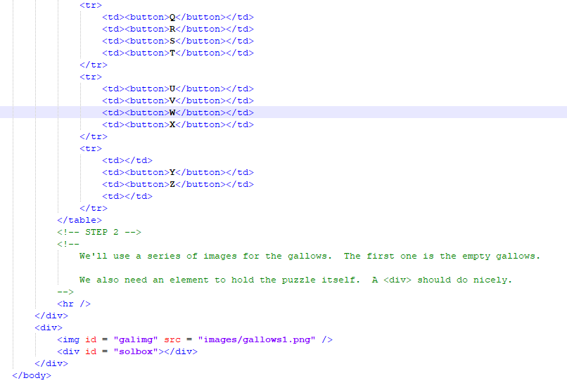
Hangman

Slide 12
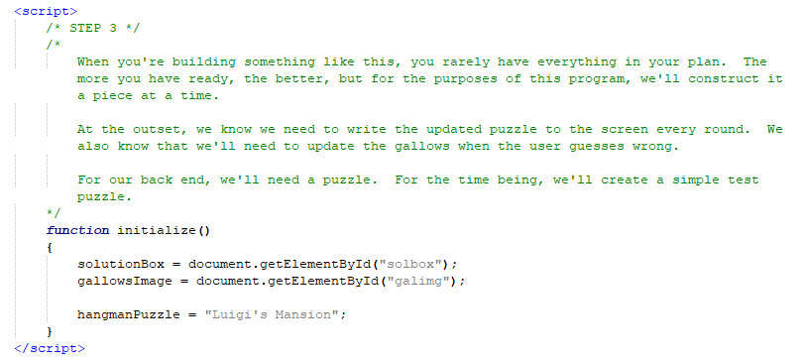
Hangman

Slide 13
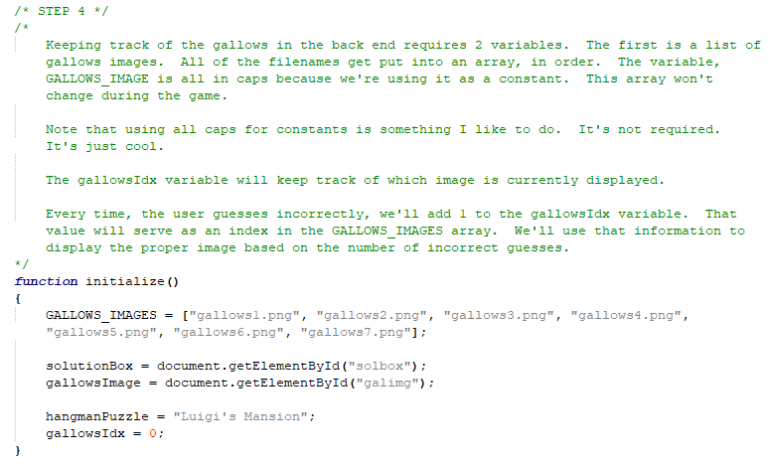
Hangman

Slide 14
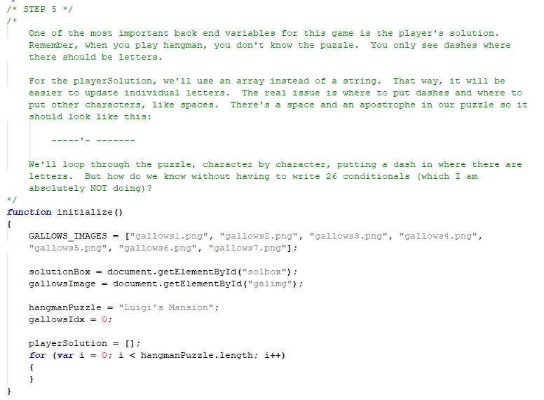

Slide 15
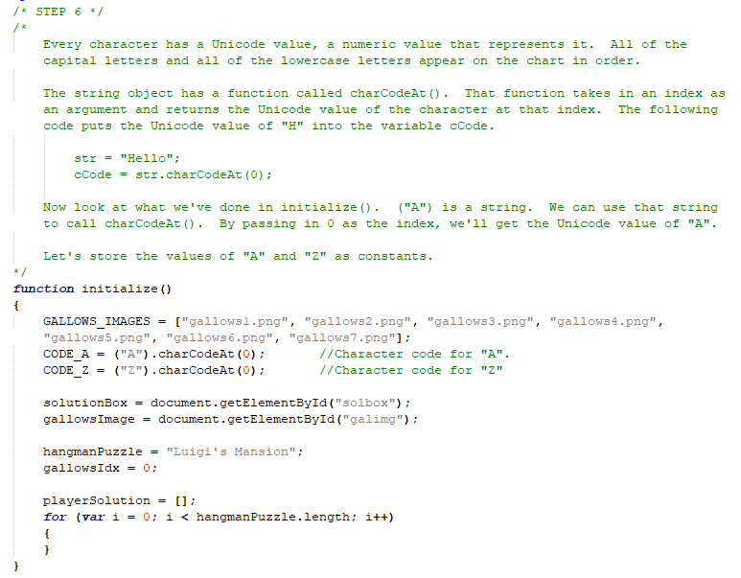

Slide 16
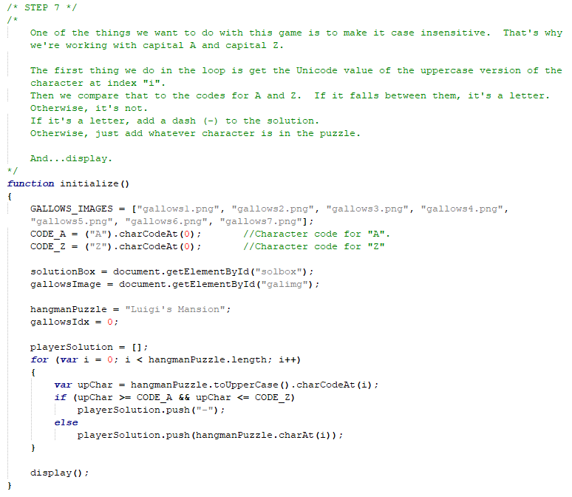

Slide 17
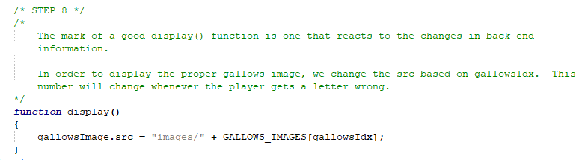
Hangman

Slide 18
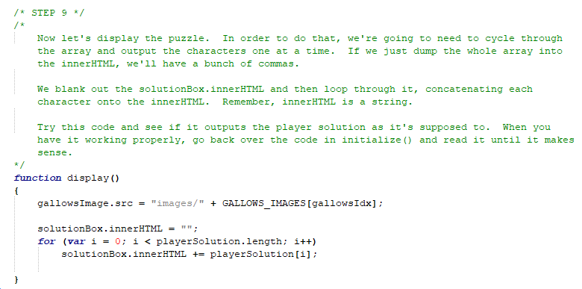
Hangman

Slide 19
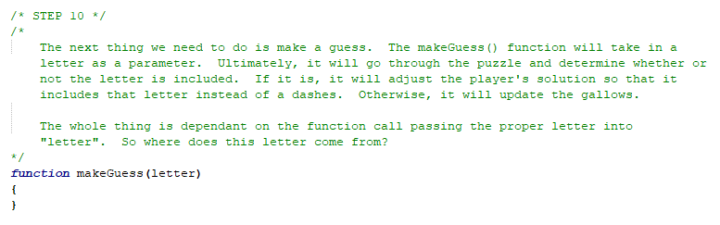
Hangman

Slide 20
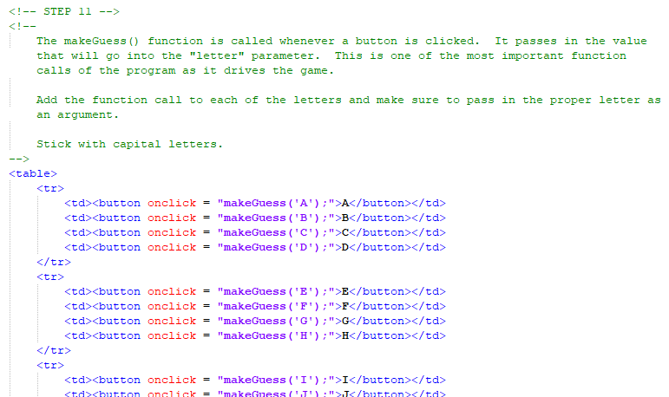
Hangman

Slide 21
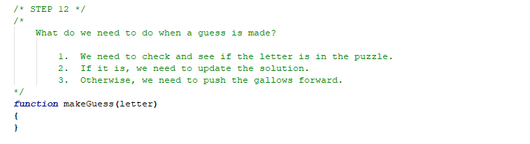
Hangman

Slide 22
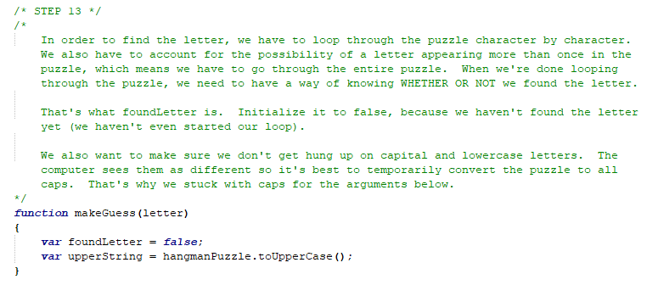
Hangman

Slide 23
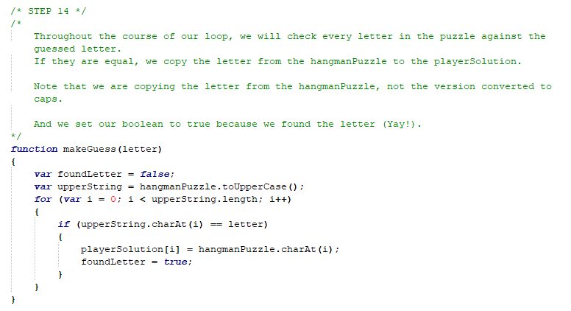
Hangman

Slide 24
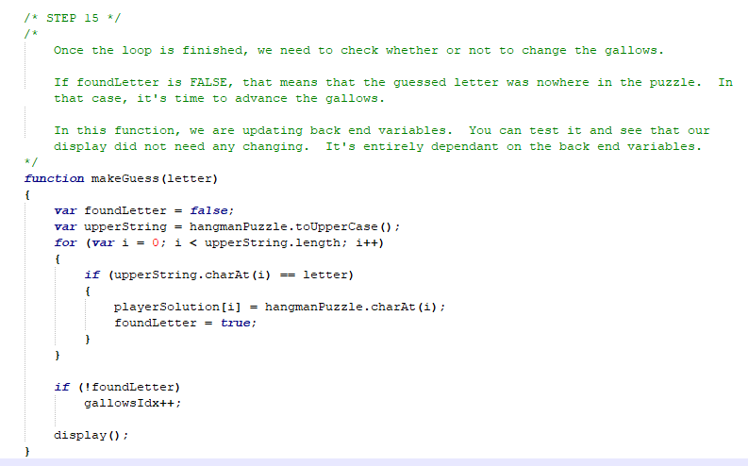
Hangman

Slide 25
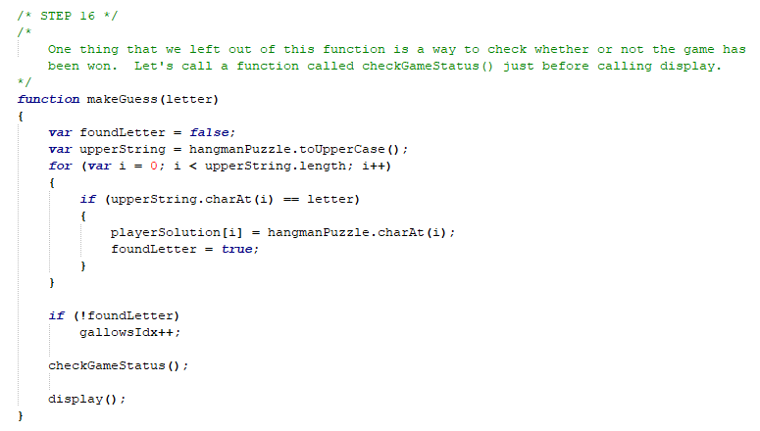
Hangman

Slide 26
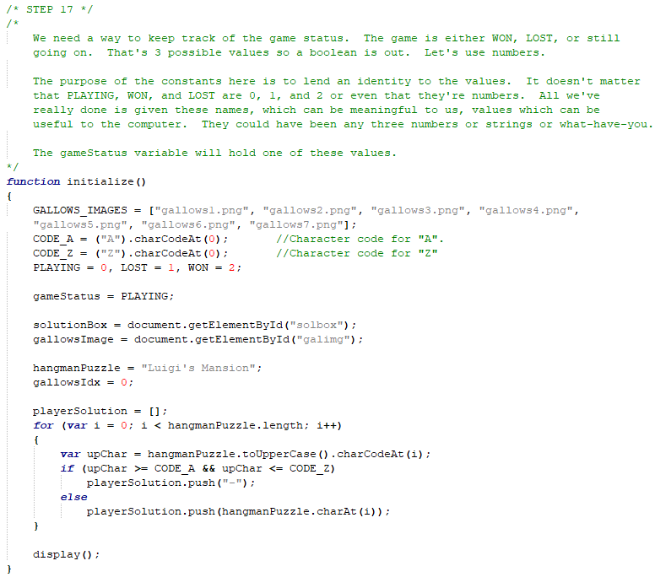

Slide 27
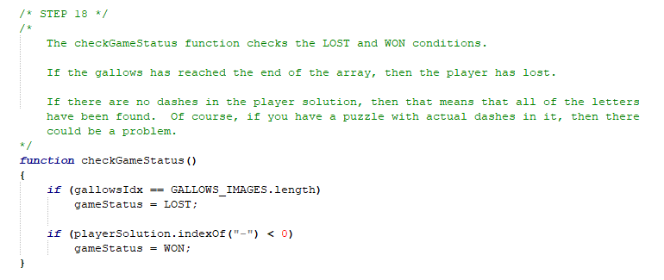
Hangman

Slide 28
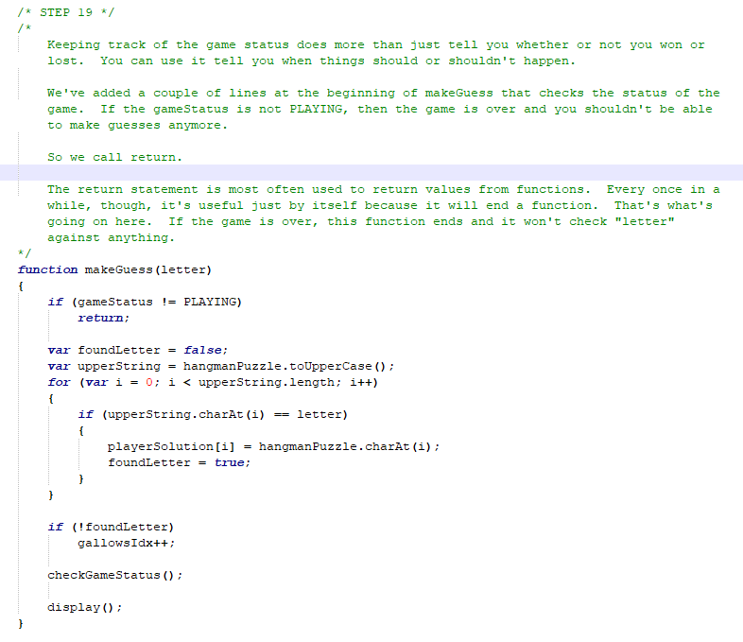

Slide 29
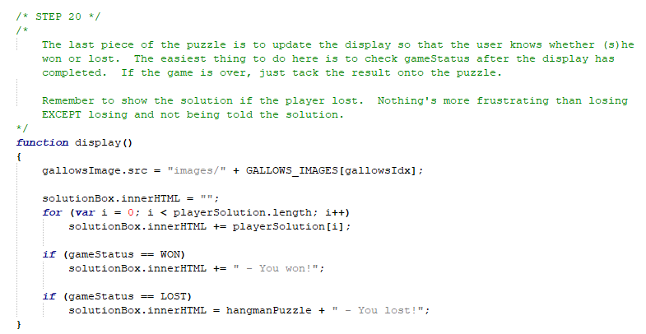
Hangman

Slide 30
Hangman
Test this thoroughly? Any bugs?

Slide 31
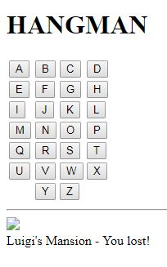
Hangman
The bug that has occurred is not your fault. It was left in there so that you could debug it. The debugger won’t give you any clues because there are no syntax errors. You need to go through this thing and figure out what’s wrong.

Slide 32
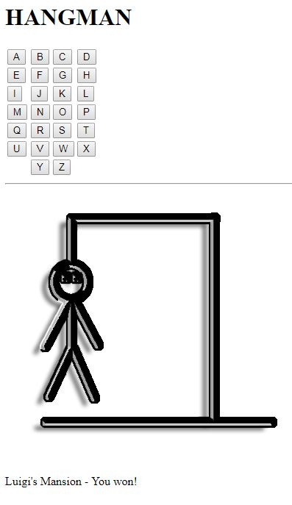
Hangman
When debugging an execution error, the first thing you need to be able to do is reproduce the error. If you can’t find the problem, you can’t solve the problem.
This particular error occurs when you lose the game. The gallows cycles through normally as you play, but you still have one more life after the last image.

Slide 33
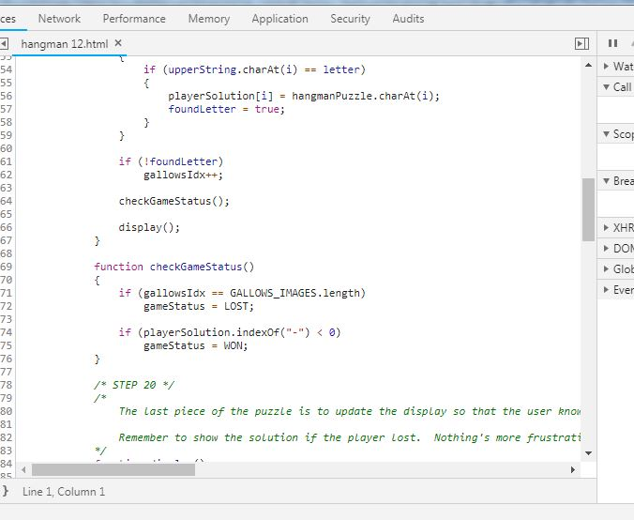
Hangman
Once you’re able to reproduce the error, the next thing to do is try and narrow it down to a function or a variable. In this case, the issue is with the gallows so there is either a problem with the gallowsIdx variable or the array itself.
The issue itself is probably occurring in checkGameStatus() because that’s where the variable that stops the game is set.

Slide 34
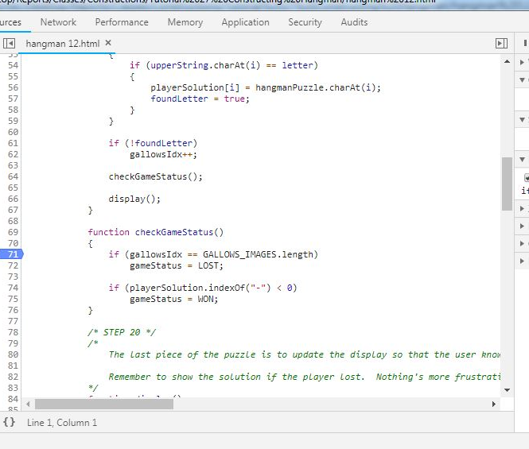
Hangman
The best way to figure out what’s going wrong with a program is to see it in action. When you go into the debugger, you can view your source code and set break points.
A break point is a point in the code where you want the execution to pause. With the execution paused, you can check out the values of variables and see how they are developing.

Slide 35
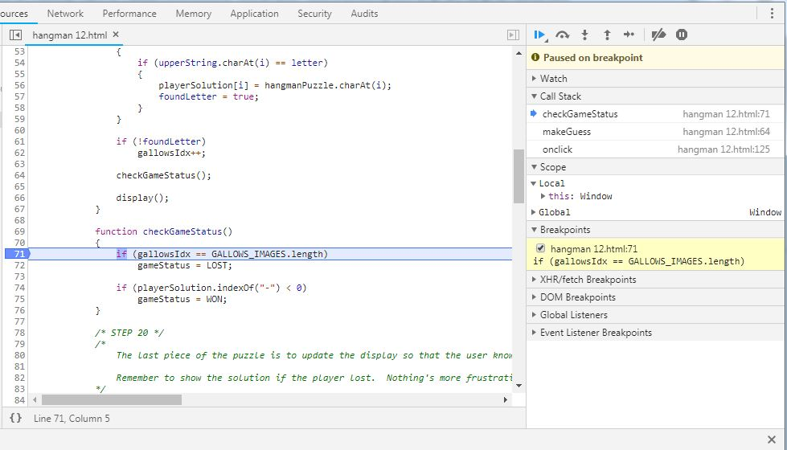
Hangman
Now, when you run the program, it will stop at that line. There’s a lot of information available and it will be useful in the future when you have a better understanding of what goes on during the execution of the program. Right now, though, let’s stick to the variables.

Slide 36
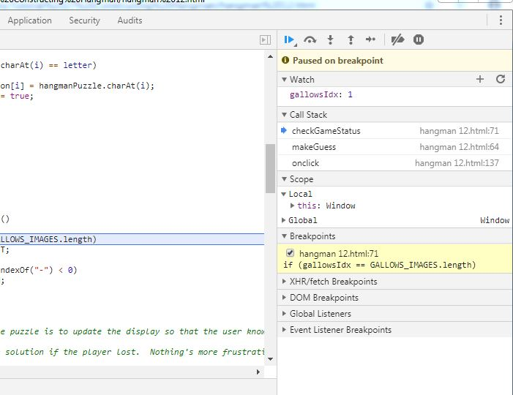
Hangman
You can check the value of a variable just by hovering over it, but if you want to track variables, you should set up a watch.
Just click on the plus (+) button and type in the name of your variable. It will then show the value of that variable at that point in the execution.
If your variable is out of scope, meaning that you’ve paused execution outside of where one of your local variables is present, then it will show up as undefined.

Slide 37
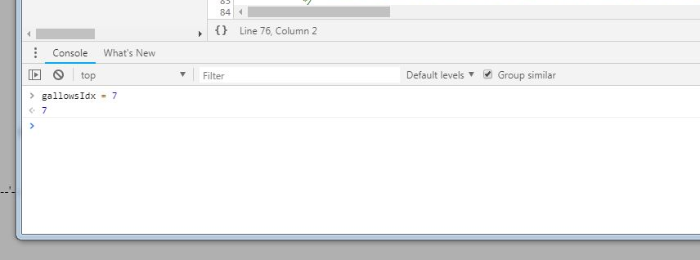
Hangman
Our situation only occurs when the player loses the game. If you know the conditions of your error, then you can alter your variables in mid execution. This way, we don’t have to play through the whole game.
In the console window, you can type code. Let’s set the gallowsIdx to 7, which is the length of the array. This will trigger the code that sets the gameStatus to LOST. Just type the code. Now your variable is set in memory.

Slide 38
Hangman
Now we need to start walking our way through the code. Above the watch window are some control buttons.
The “play” button (F8) resumes the execution of the code beyond the break point.
The curved arrow (F10) is the “step over” function. If you are stopped on a function, this will execute the function without stepping into it.
The down arrow (F11) is the “step into” function. If you are stopped on a function, this will bring you into the function and you can execute it line by line. This only works with functions that you have defined so don’t get any ideas about stepping into getElementById().
The up arrow (SHIFT + F11) is the “step out of” function. If you’re executing the code in a function and you’ve seen what you need to see, you can use this to return to the function call.

Slide 39
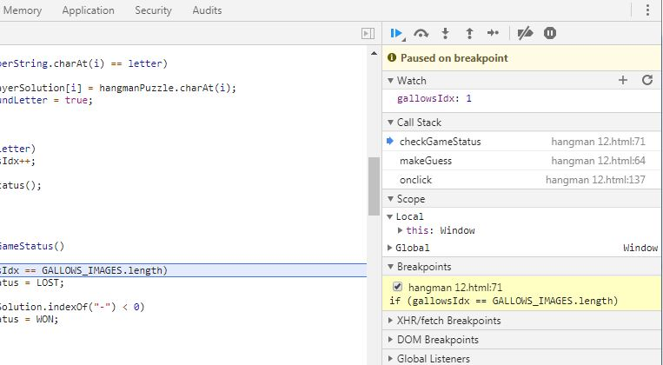
Hangman
Text

Slide 40
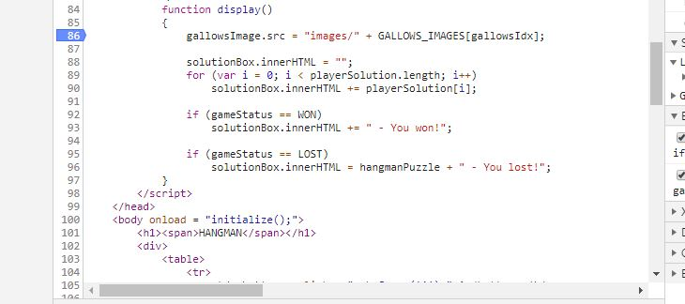
Hangman
It seems to be working. If I press F10 (use the step over function), it goes to the next line and sets the gameStatus to LOST.
Since this is working, let’s jump into display and see if there’s a front end issue.
Set a breakpoint at the very beginning of display() and press F8 to “play” the page. It will break as soon as it hits the new breakpoint.

Slide 41
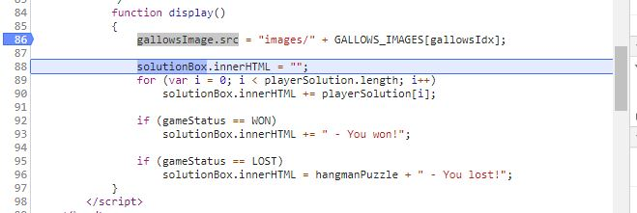
Hangman
If you take one more step and check the value of gallowsImage.src, you’ll see that it’s undefined.
That means that the value put into that variable was bad. Since that value came from GALLOWS_IMAGES[gallowsIdx], let’s have a look at that.

Slide 42
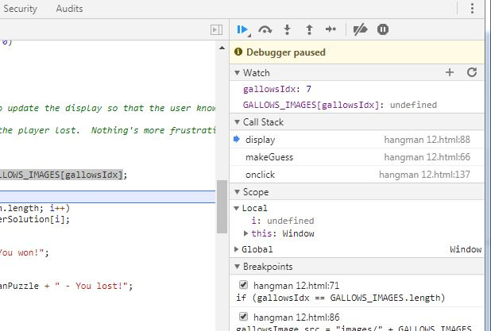
Hangman
Undefined! How did that happen?

Slide 43
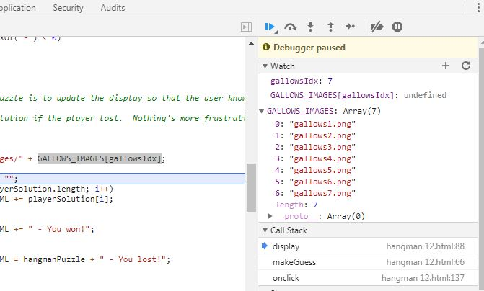
Hangman
Aha! Do you see it?
gallowsIdx is 7, which is the length of the array. The indices, however, only go up to 6. We went one index past the end of the array.

Slide 44
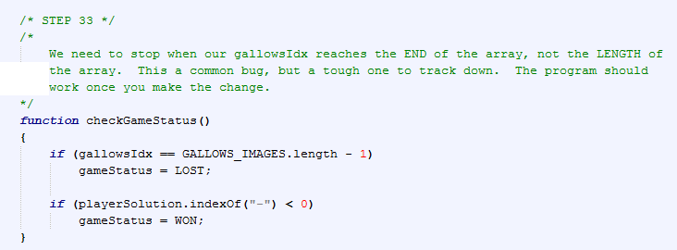
Hangman

Slide 45
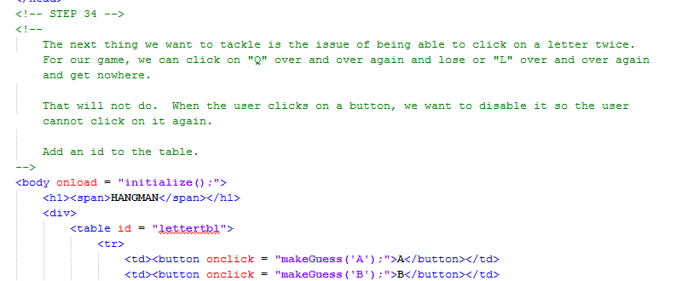
Hangman

Slide 46
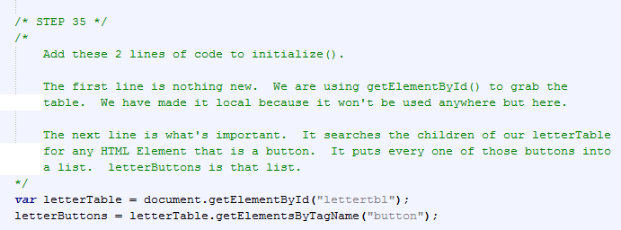
Hangman

Slide 47
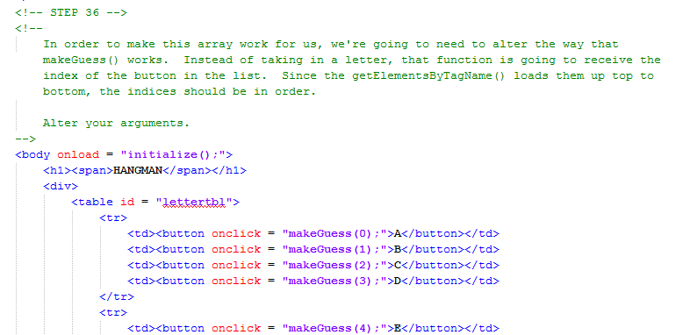
Hangman

Slide 48
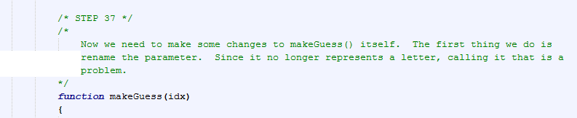
Hangman

Slide 49
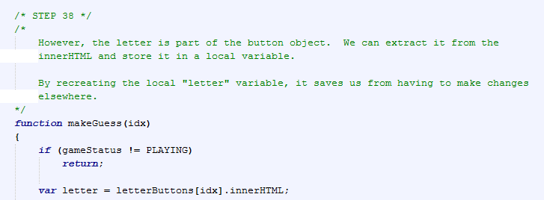
Hangman

Slide 50
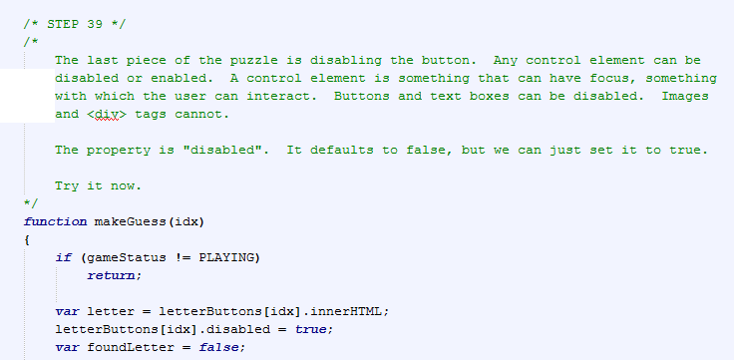
Hangman

Slide 51
Hangman
There’s a lot more that needs to be done with this program. There should be a text box that allows the user to make a guess without having to click on each letter. There should be a reset button. There should be multiple puzzles, one of which is chosen randomly at the start of the game. There should definitely be front end styling with CSS.
Implementing these pieces is good practice before moving into your Level 3.

Slide 52
A DEEPER MEANING

Slide 53
A Deeper Meaning
As a programmer, you should live by two rules.
Code from back to front.
Code in parts.

Slide 54
A Deeper Meaning
Coding from back to front means that you will always secure your back end before coding the design of your front end. Like everything else, this isn't as simple a rule as it seems. You should always have a general idea of what your page is going to look like. Understanding the interface you're going to create will help you to figure out what pieces you need to make in order to put it all together. But it often happens that the coding of your back end forces you to make changes to your up front design. If you've already spent a month making your page look pretty, you're not going to want to have to do all of that work over again.

Slide 55
A Deeper Meaning
Coding in parts is much more straightforward. During your planning and analysis, your project should naturally break down into pieces. You should code these pieces individually and test each piece. That way, as you add more pieces and discover errors, you'll find that it's easier to track down the bugs. There’s nothing worse than writing 10000 lines of code and then testing it for the first time.

Slide 56
FAQ

Slide 57
FAQ
Do I need to debug every program?
Unless you have your own private tester, yes. It’s good to have others try your code. They are more likely to break it and they can give you feedback on the interface..

Slide 58
ACTIVITY

Slide 59
Level 3
Choose and complete a Level 3 Project.
You’re ready.

